Slide 1
The Future of GRC
A Rapid Deployment System For Small To Medium Size Healthcare Multi-Practice Clinic
6 Steps To Success
By Jed A. Reay January 24, 2023
Notes:
Specifically, this facility would have 2 Internal Medicine physicians, 1 General practitioner, 1 nurse practitioner, 1 Generalist PA, 1 cardiologist, 1 oncologist, 1 Geriatrics physician , 1 Orthopedic physician and all the staff to support such a practice.
Governance, Risk, and Compliance (GRC) is a structured way to align IT with business goals while managing risks and meeting all industry and government regulations. It includes tools and processes to unify an organization's governance and risk management with its technological innovation and adoption.

Slide 2
Why? > 40 Years of business development & strategic planning > 30 Years of diverse healthcare experience > Logical step apply cybersecurity to what I already know

Slide 3
Fig. 1 reference: https://riskwrangler.com/IRMonPage
Notes:
This page came from a OCEG webinar 1/19/2023 “The Root of the Compliance vs Security Paradox
Frameworks / Standards / Regulations
The National Institute of Standards and Technology (NIST) and the International Organization for Standardization (ISO) are the leading standards bodies in cybersecurity.
HIPAA

Slide 4
<> NIST https://nist.gov <> ISACA https://isaca.org <> ISO https://iso.org <> MITRE https://mitre.org <> COBIT https://www.isaca.org/resources/cobit <> HIPAA https://www.hhs.gov/hipaa/index.html <> HIMSS https://www.himss.org <> PCI https://www.pcisecuritystandards.org <> HITRUST https://hitrustalliance.net <> NERC https://www.nerc.com <> CIS https://www.cisecurity.org <> CMMC https://dodcio.defense.gov/CMMC <> UCF https://www.unifiedcompliance.com <> Soc 1 & 2 https://socreports.com/audit-overview/soc-1-vs-soc-2 <> OSHA https://www.osha.gov <> OFAC https://home.treasury.gov/policy-issues/office-of-foreign-assets-control-sanctions-programs-and-information
Notes:
NIST National Institute of Standards and Technology
ISACA “The association was incorporated as the EDP Auditors Association in 1969 by a small group of individuals who recognized a need for a centralized source of information and guidance in the new field of electronic data processing audit.”
ISO “ISO is an independent, non-governmental international organization with a membership of 167 national standards bodies.” MITRE “Is a globally-accessible knowledge base of adversary tactics and techniques based on real-world observations.”
COBIT “Control Objectives for Information and Related Technologies. COBIT is an IT management framework developed by the ISACA to help businesses develop, organize and implement strategies around information management and governance.” HIPAA “Health Insurance Portability and Accounting” HIMSS “HIMSS (Healthcare Information and Management Systems Society) is a global advisor, thought leader and member-based society committed to reforming the global health ecosystem through the power of information and technology.” PCI “Security Standards Council Specifically, it refers to the technical and operational standards that businesses need to follow to protect credit card data.” HITRUST “The HITRUST Approach provides organizations a comprehensive information risk management and compliance program to provide an integrated approach that ensures all programs are aligned, maintained and comprehensive to support an organization’s information risk management and compliance objectives.” CIS “CIS is a forward-thinking nonprofit that harnesses the power of a global IT community to safeguard public and private organizations against cyber threats.”
CMMC “The Cybersecurity Maturity Model Certification (CMMC) is the Department of Defense's (DoD) newest verification mechanism designed to ensure that cybersecurity controls and processes adequately protect Controlled Unclassified Information (CUI) that resides on Defense Industrial Base (DIB) systems and networks.” UCF “Unified Compliance has developed ground-breaking tools to support IT best practices with a special focus on regulatory compliance, metrics, systems continuity, and governance.”
SOC1 “A SOC 1 report is for service organizations that impact or may impact their clients' financial reporting.”
SOC2 “SOC 2 report is for service organizations that hold, store or process information of their clients, but is not significant to financial reporting”
OSHA “Congress created the Occupational Safety and Health Administration (OSHA) to ensure safe and healthful working conditions for workers by setting and enforcing standards and by providing training, outreach, education and assistance.”
OFAC “The Office of Foreign Assets Control (OFAC) is a financial intelligence and enforcement agency of the U.S. Treasury Department. It administers and enforces economic and trade sanctions in support of U.S. national security and foreign policy objectives”

Slide 5
1. Review and update existing governance framework (HIPAA, HITRUST, ISO 27799, NIST, SOC 2), code of conduct, and policies and procedures to ensure they align with the specific needs of the clinic and any relevant laws and regulations in Eugene, OR. 2. Assess the current state of risk management, incident management, data security, and access controls in the clinic, and identify any areas that need improvement. 3. Develop a plan to address any identified gaps in risk management, incident management, data security, and access controls, and set a timeline for achieving compliance. 4. Communicate the plan to all stakeholders and ensure that everyone understands their role and responsibilities in implementing the plan. 5. Establish a system for monitoring and reporting on progress towards achieving compliance. 6. Regularly review and update the plan as needed to ensure that it continues to meet the needs and security of the clinic and remains compliant with any and all relevant laws and regulations.
Notes:
1 Review and Update 2 Assess current status 3 Develop a plan 4 Communicate the plan 5 Establish a system Monitoring and reporting 6 Regular review/adjustments

Slide 6
<> To-date GRC programs generally are Entity specific <> Complexed, complicated, detailed, and verbose <> Costly, and may or may not be cost effective <> Complicated to communicate and train or teach <> Can become unmanageable <> Can be ineffective

Slide 7
Bringing GRC into the 24th Century
AI has many new capabilities that can aid us in accomplishing many tasks that are Complex, Complicated, Detailed, and Verbose.
ChapGPT and others AI tools will help to shorten the time-to-implementation process.

Slide 8
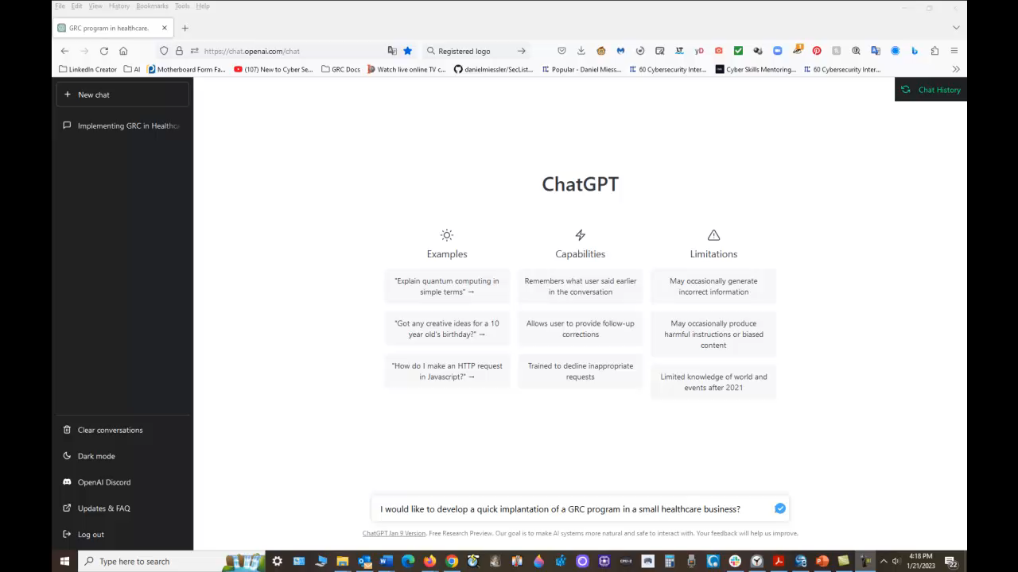

Slide 9
<> Hypothesis, based on this current criteria would not have been confirmed. <> Further developments of the current Open Source AI systems will need to improve. <> ChatGTP needs further learning or be allowed to connect to the internet. (Not anytime soon). <> Supporting Docs: http://tiny.cc/wio3vz <> Thank you <>

Slide 10


